Slide 1
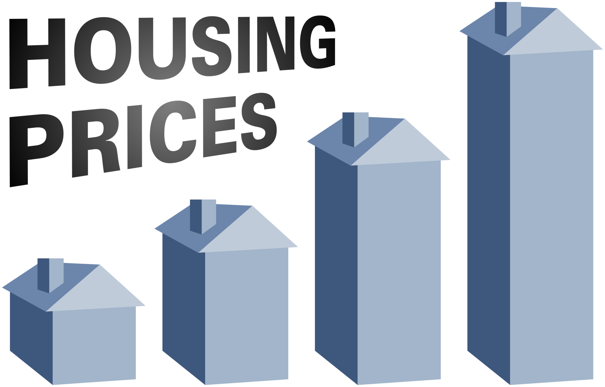
Housing Price Prediction
Submitted by: Junaid Shaikh
FlipRobo Technologies

Slide 2
Table of Contents
Introduction
Analytical Problem Framing
Data Preparation
Data Analysis
Model Development & Evaluation
Results
Conclusion
Limitation and scope for future work

Slide 3
Introduction
Houses are one of the necessary need of each and every person around the globe and therefore housing and real estate market is one of the markets which is one of the major contributors in the world’s economy. It is a very large market and there are various companies working in the domain.
A US-based housing company named Surprise Housing has decided to enter the Australian market. The company uses data analytics to purchase houses at a price below their actual values and flip them at a higher price. For the same purpose, the company has collected a data set from the sale of houses in Australia.
The company is looking at prospective properties to buy houses to enter the market. You are required to build a model using Machine Learning in order to predict the actual value of the prospective properties and decide whether to invest in them or not. For this company wants to know:
Which variables are important to predict the price of variable?
How do these variables describe the price of the house?

Slide 4
Analytical problem framing
In this Machine Learning project, I will be predicting the sale price of the houses in Australian region using the provided dataset
The Surprise Housing company expects us to predict the sale price of the house along with the important variables which helps in prediction of the same
Further, we will also learn on how these variables describe the sale price of the house
The provided dataset consists of 1460 rows and 81 features (including train and test dataset)

Slide 5
Data Preparation
There are missing data in some of the variables which needs to be handled & categorical column also needs to be converted into numerical column.
We can fill null values of categorical columns with 0 as it basically represents that, the feature is not available for the property.
For missing values in numerical column, we can fill them mean of the resp column.
Next step is to assign every categorical data a unique value.
With this the data-frame has been cleaned and transformed properly for us to start analysing.

Slide 6
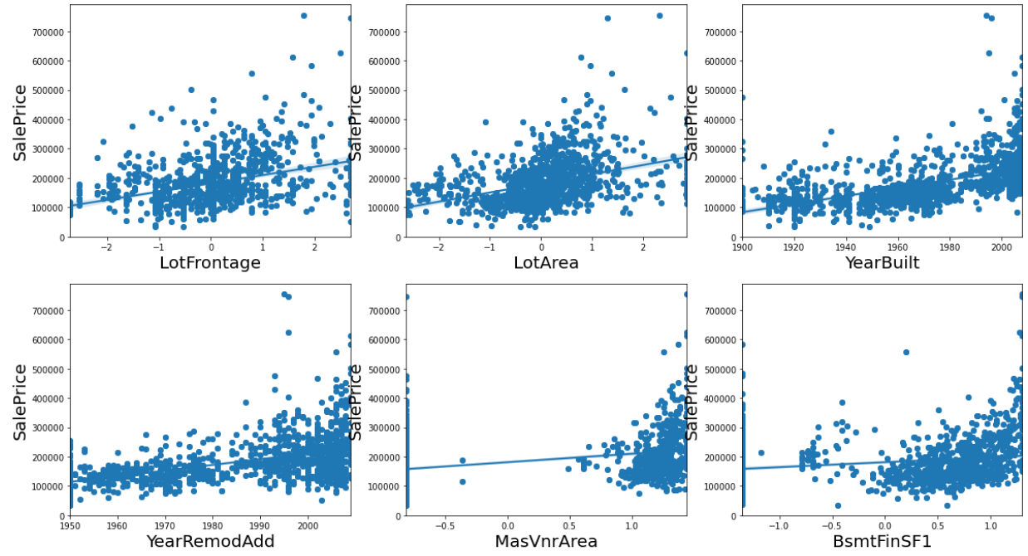
Data analysis
Check the relation of numerical columns w.r.t SalePrice by using scatter plot & Regplot

Slide 7
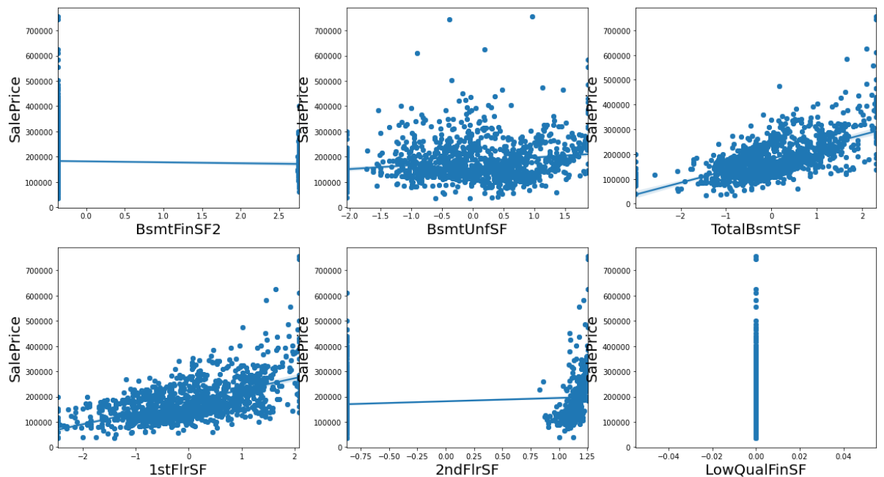

Slide 8
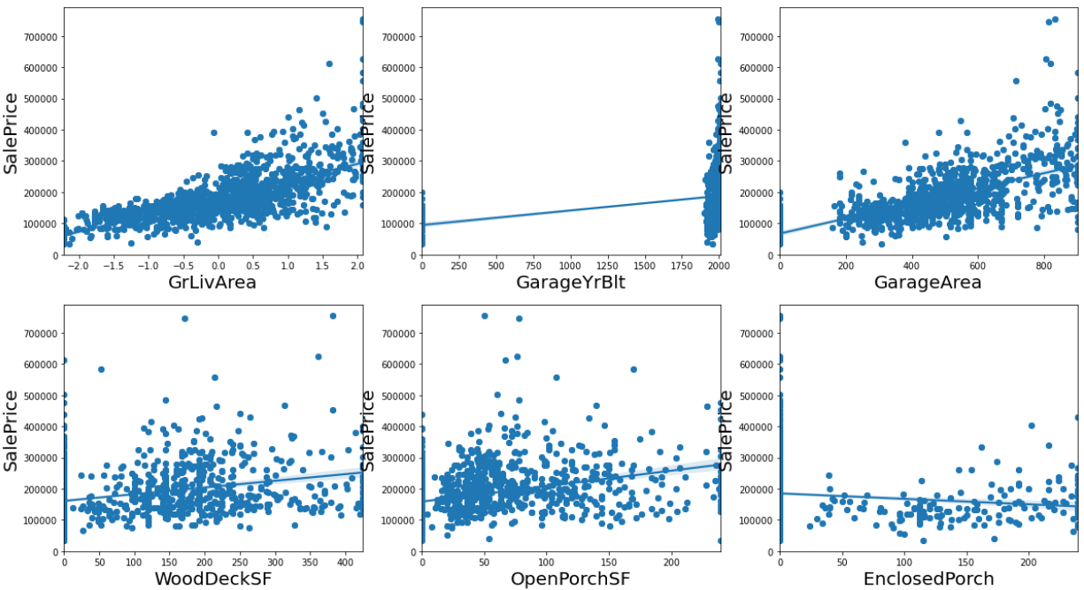

Slide 9
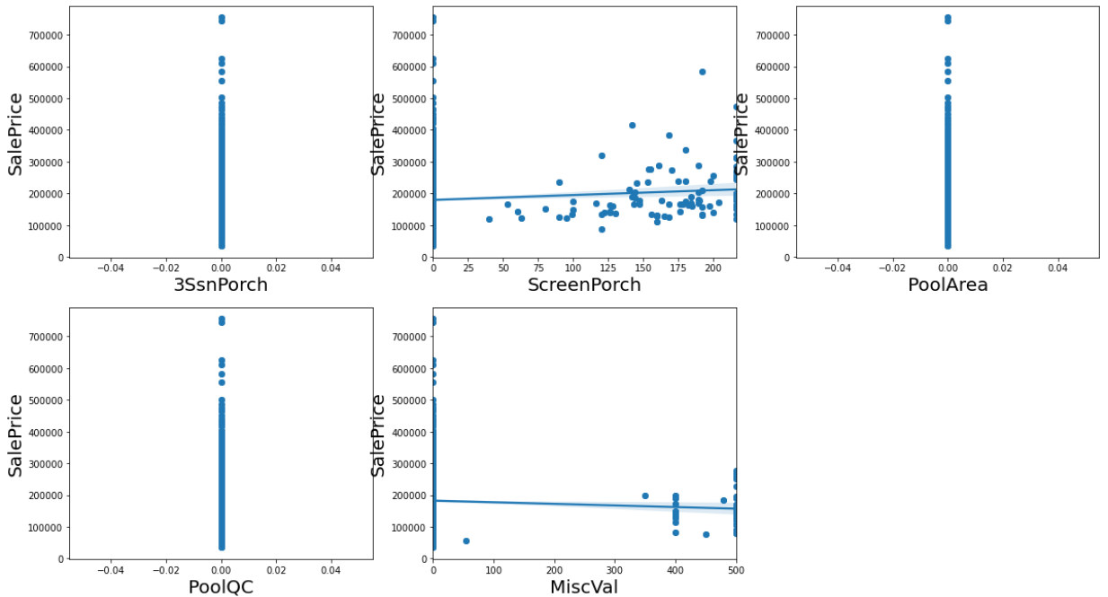

Slide 10
Data Analysis
Observation:
Columns such as OpenporchSF, WoodDeckSF, GarageArea, GarageYrBuilt, GrlivArea, 1stflrsf, 2ndflrsf, totalbsmtsf, YearremodAdd, Yearbuilt, lotfrontage, lotarea, masvnrarea, bsmntfinsf1 have positive correlation w.r.t salesprice
Columns such as MiscVal, Enclosedporch have slight negative correlation
Remaining columns do not have any correlation w.r.t salesprice

Slide 11
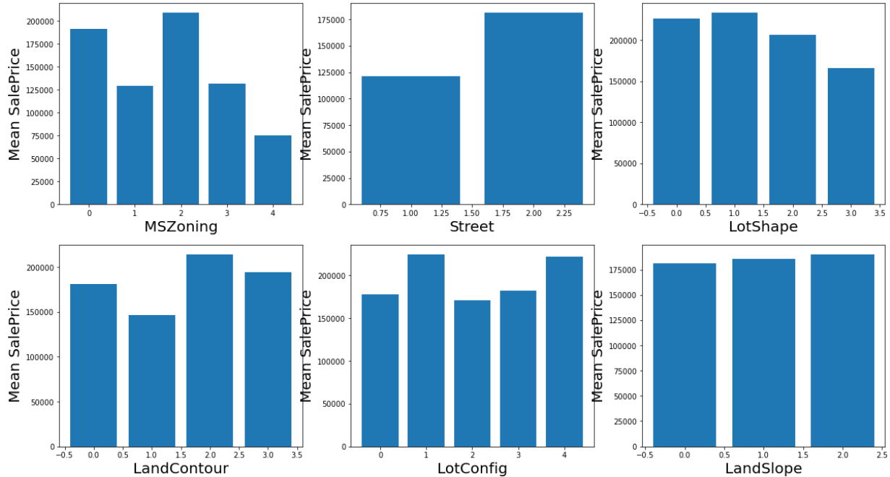
Data Analysis
Now Plot graph showing categorical columns value point and the respective mean value of salesprice for that category to verify how different datapoints are affecting SalePrice value

Slide 12
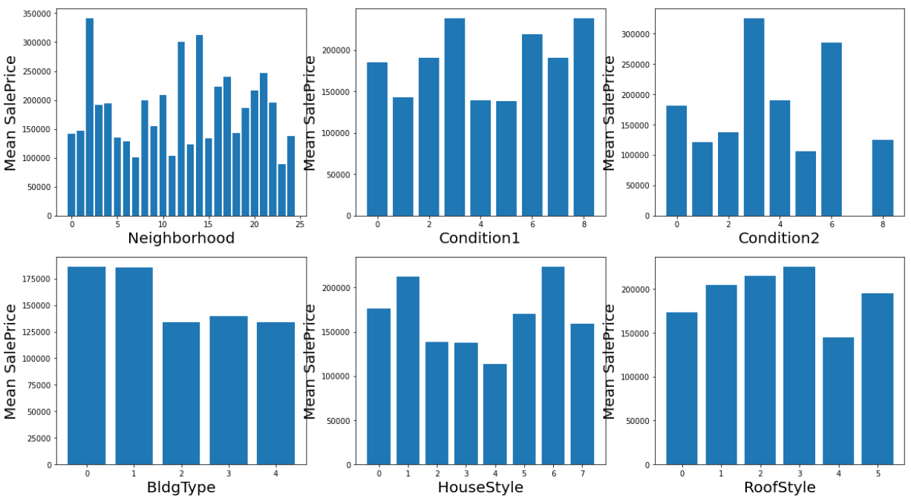

Slide 13
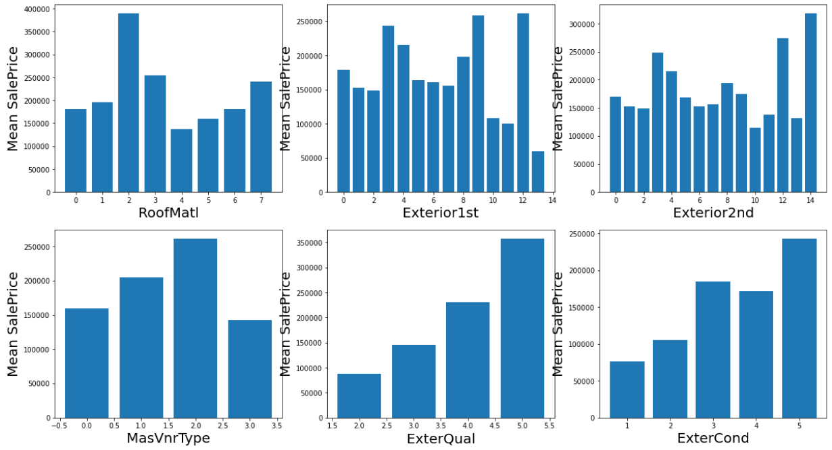

Slide 14
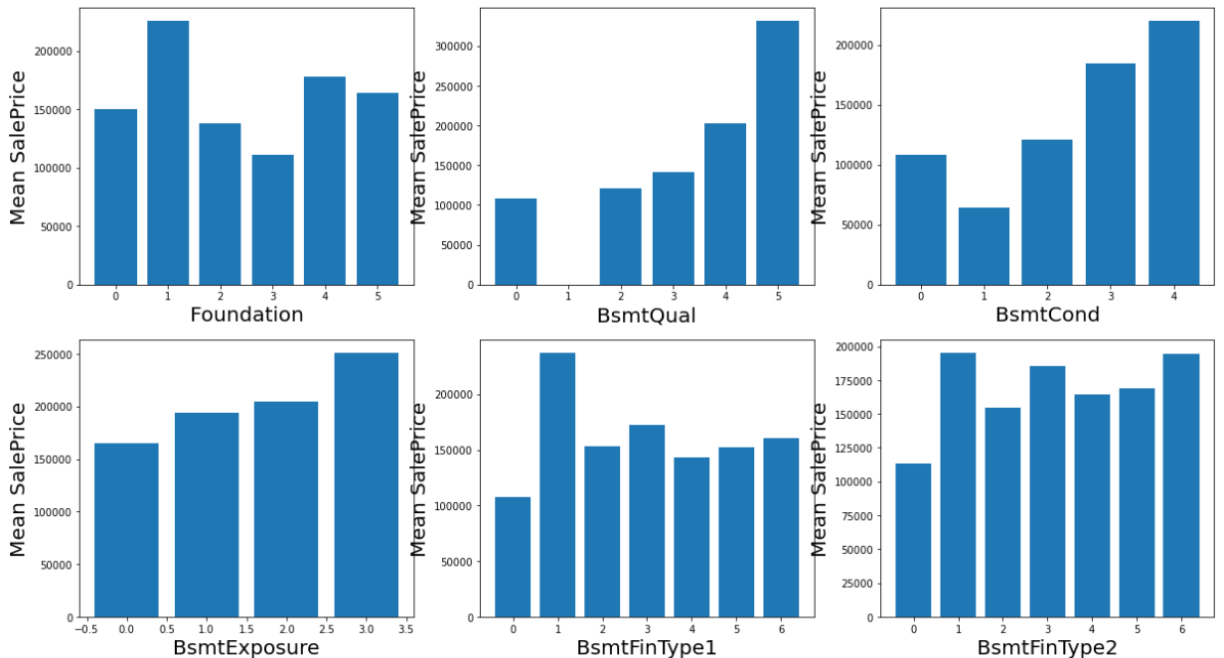

Slide 15
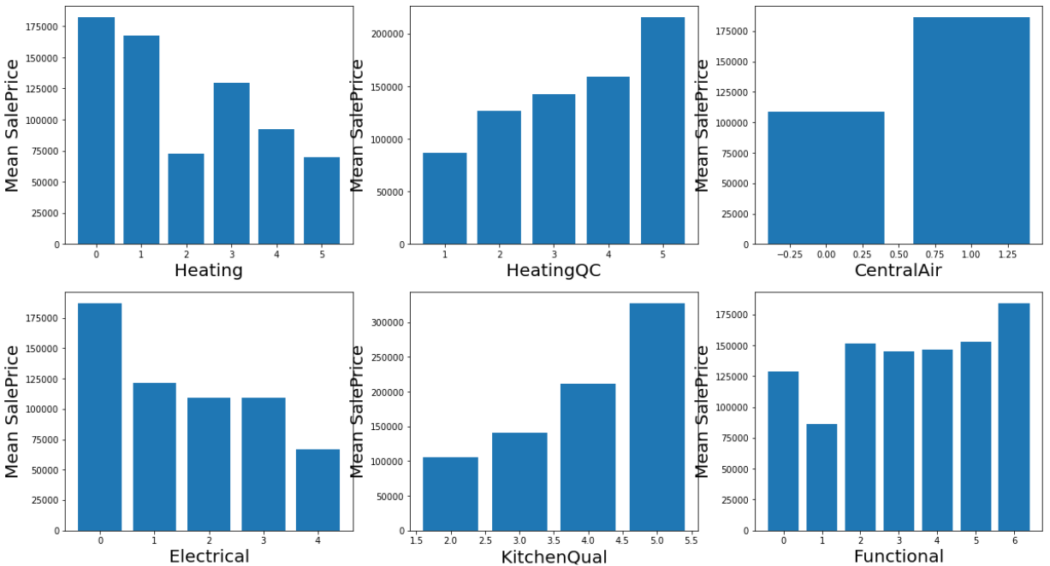

Slide 16
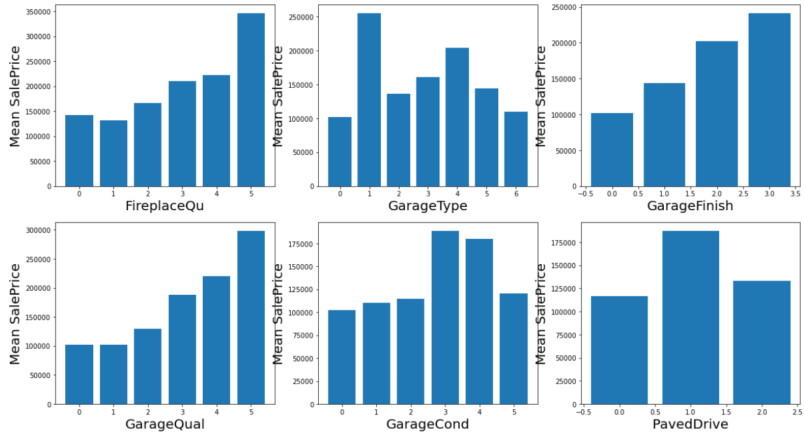

Slide 17
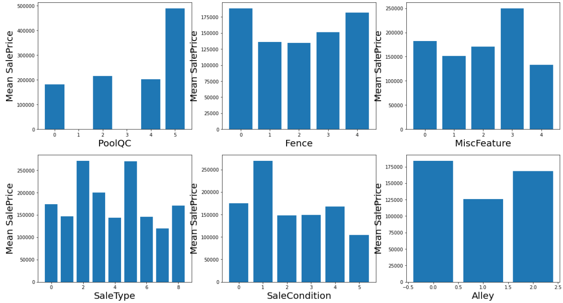

Slide 18
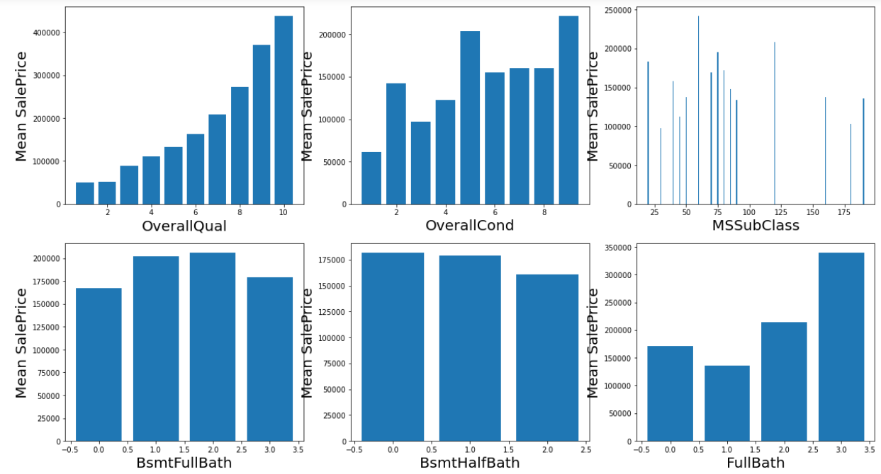

Slide 19
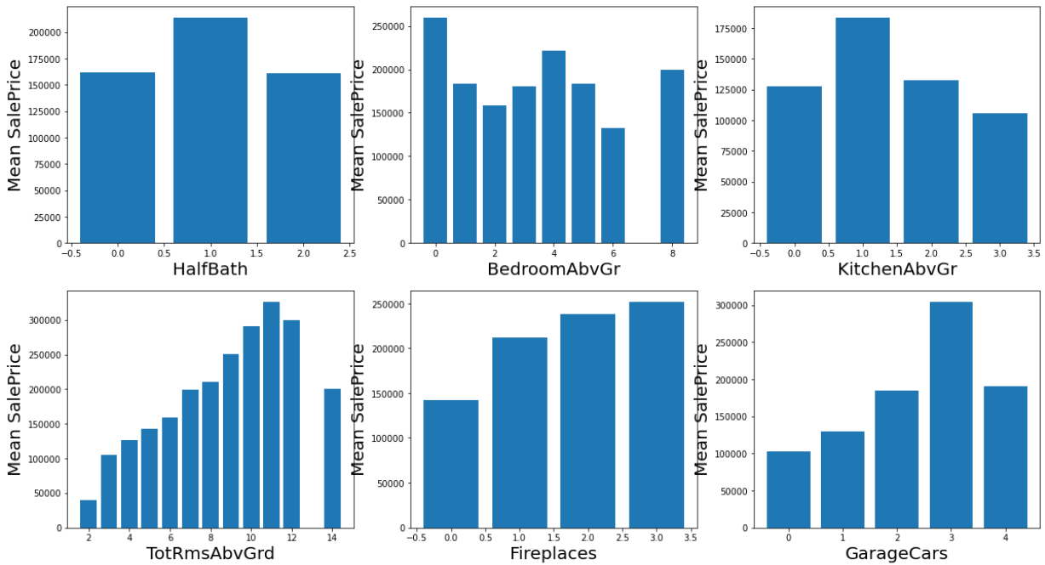

Slide 20
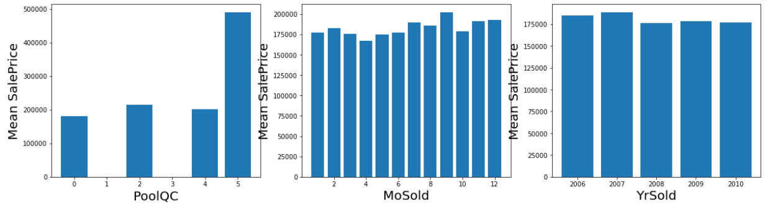
Data Analysis
Observations:
From above we can observe that categorical datapoints of columns LandSlope, MoSold, YrSold, BsmtFullBath, BsmtHalfBath have equal mean value of salesprice throughout their respective category, hence drop them.

Slide 21
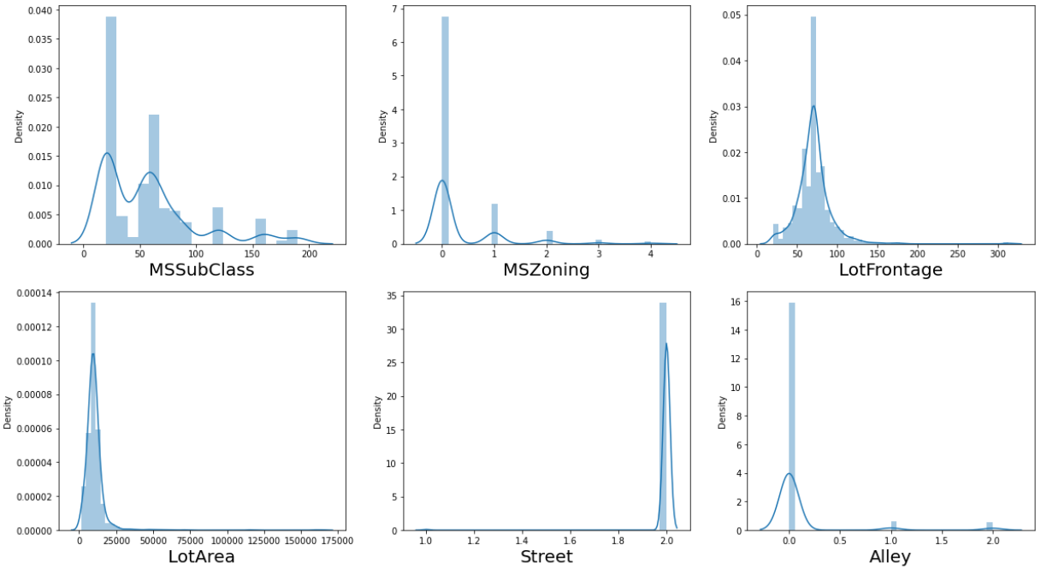
Data Analysis
Plot Distribution plot of each column

Slide 22
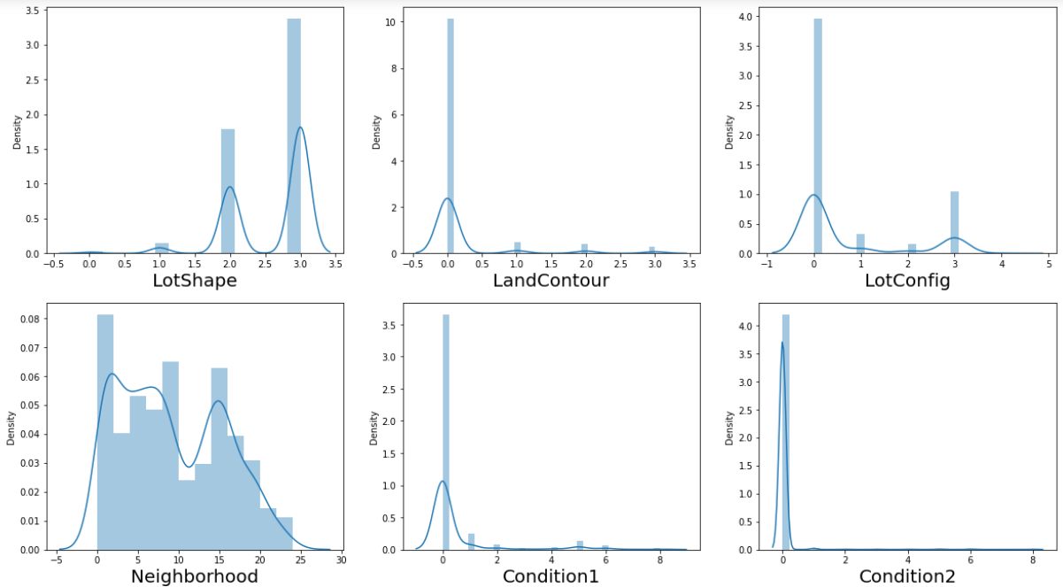

Slide 23
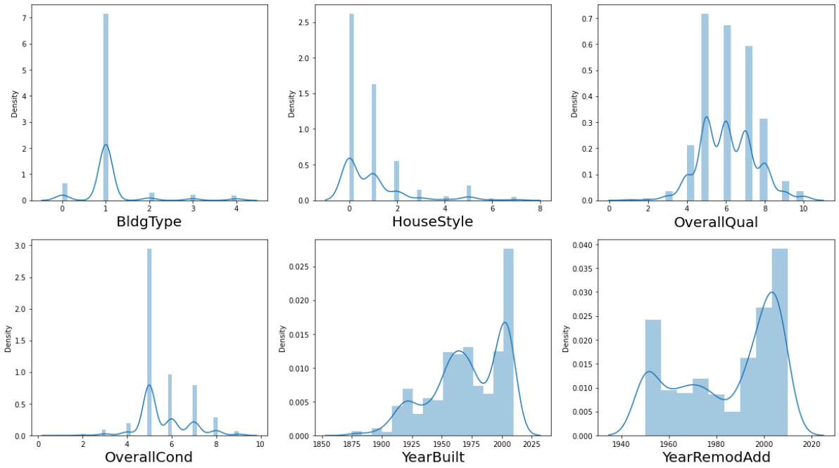

Slide 24
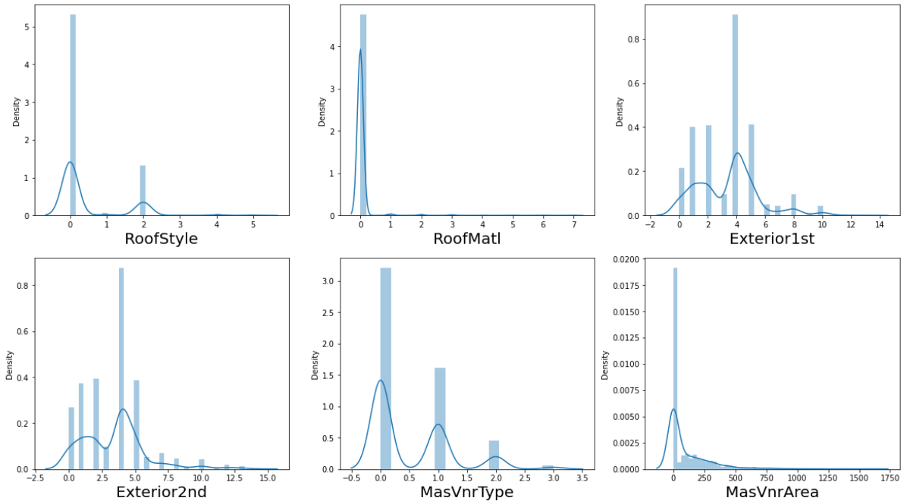

Slide 25
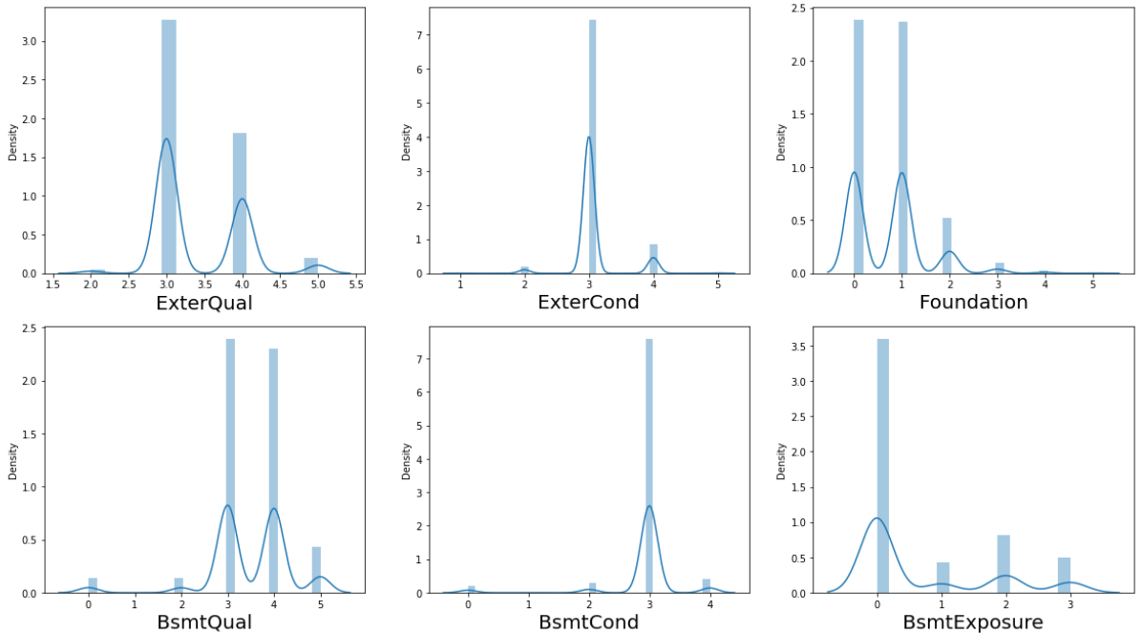

Slide 26
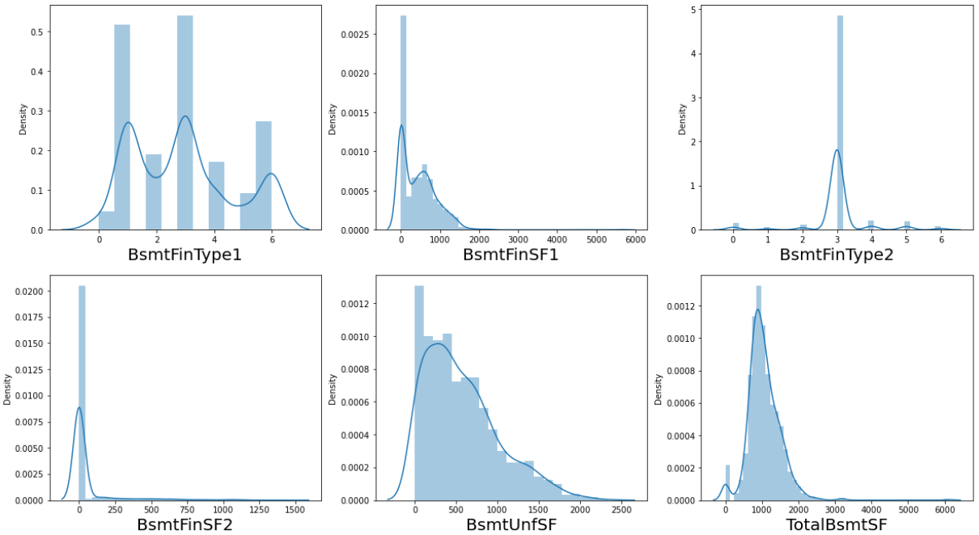

Slide 27
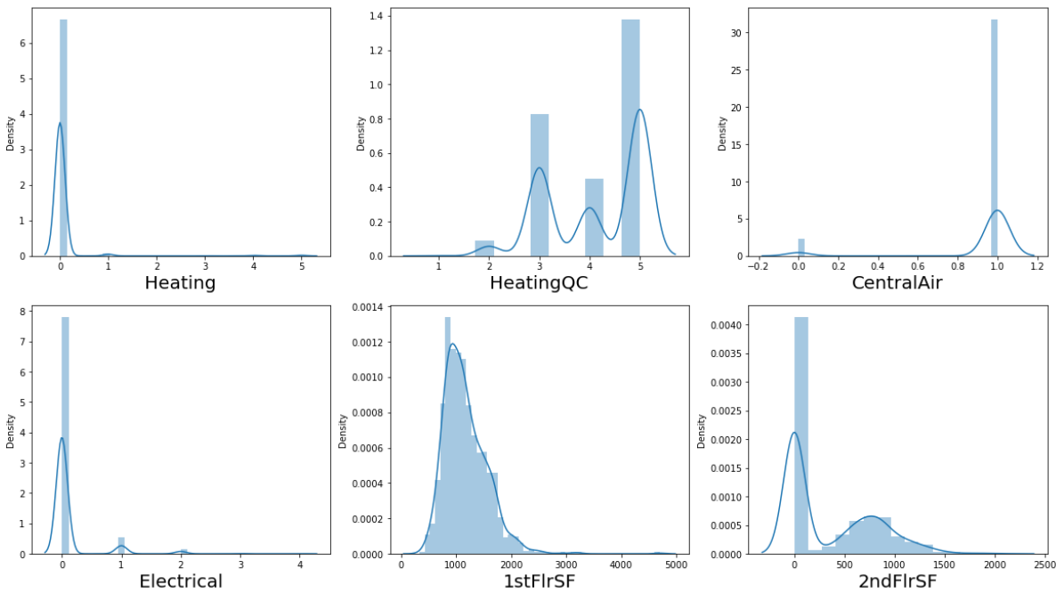

Slide 28
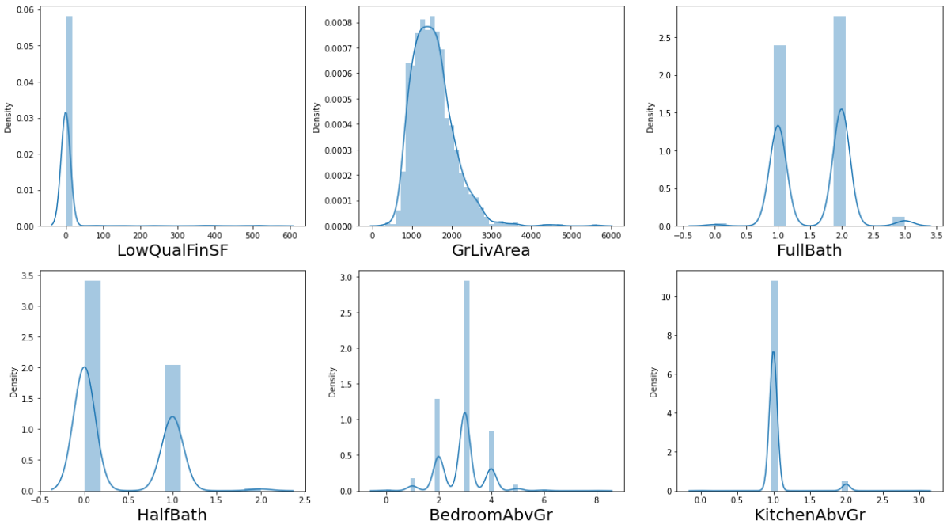

Slide 29
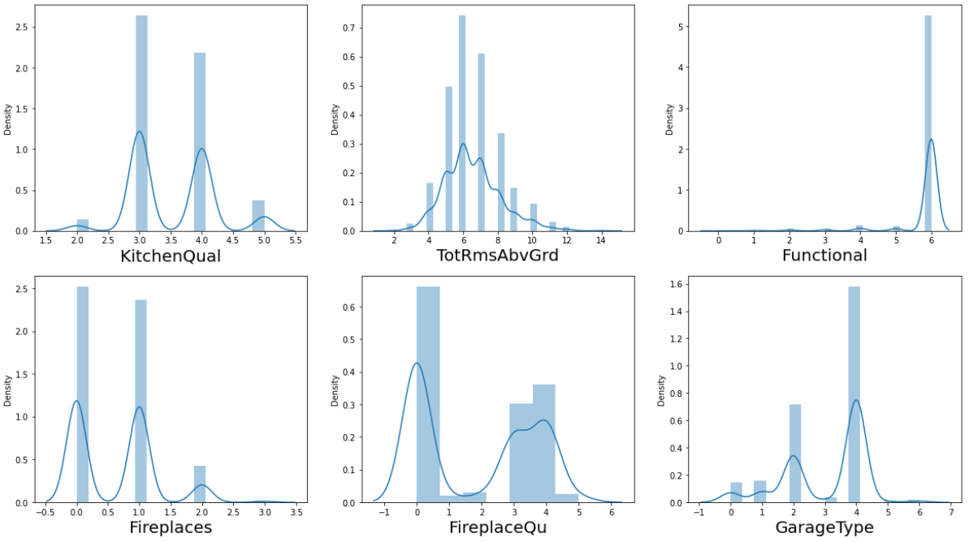

Slide 30
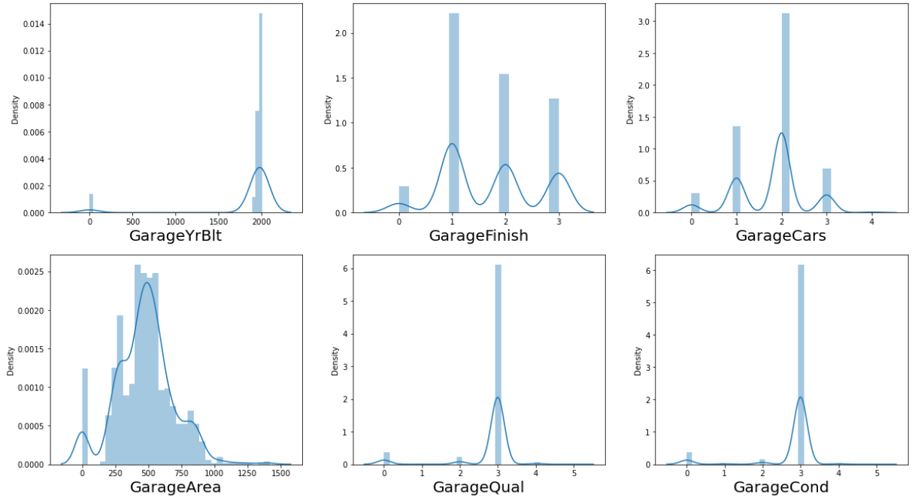

Slide 31
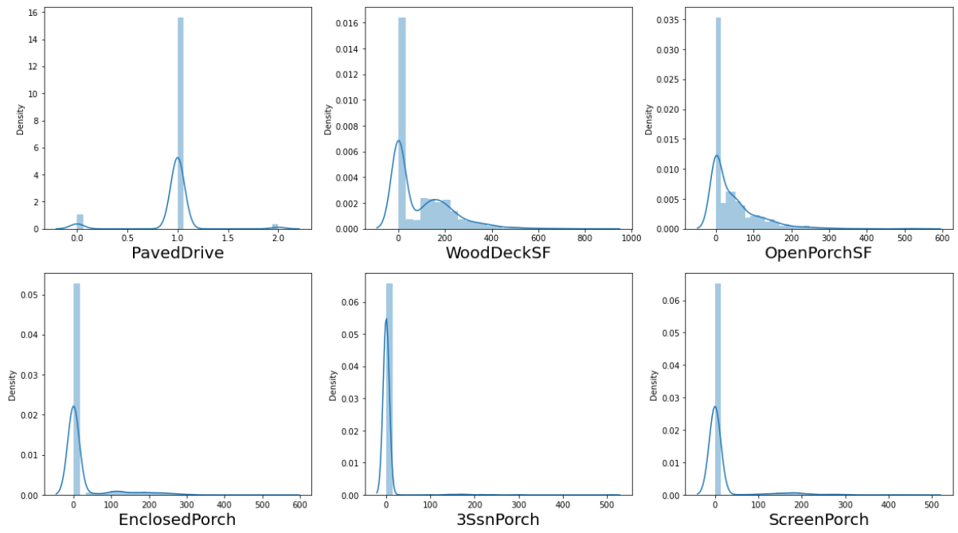

Slide 32
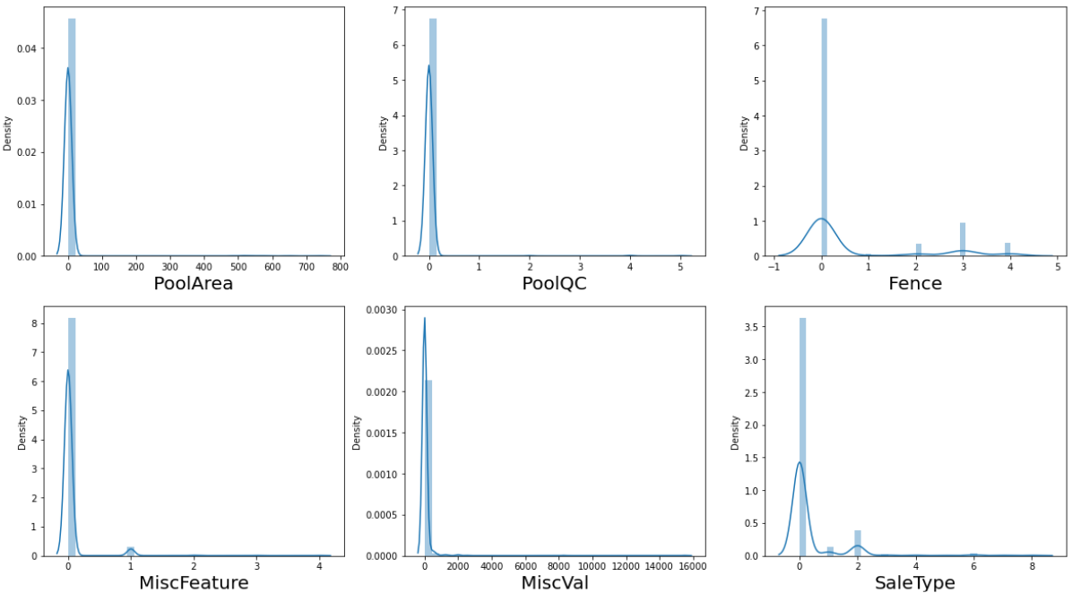

Slide 33
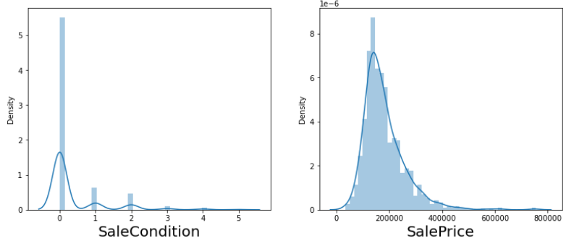
Data Analysis
Observation:
Columns having normal distribution plots are: LotFrontage, Alley, LandContour, Condition1, Conditional2, BldgType, RoofMatl, MasVnrArea, BsmtCond, BsmtFinType2, BsmtFinSF2, LotArea, BsmtUnfSF, TotalBsmtSF, Heating, CentralAir, Electrical, 1stFlrSF, LowQualFinSF, GrLivArea, KitchenAbvGr, Functional, GarageYrBlt, Street, GarageQual, GarageCond, PavedDrive, OpenPorchSF, EnclosedPorch, 3SsnPorch, ScreenPorch, PoolArea, PoolQC, Fence, MiscFeature, MiscVal, SaleType, SalePrice
Rest all columns have bimodal type distribution plot.

Slide 34
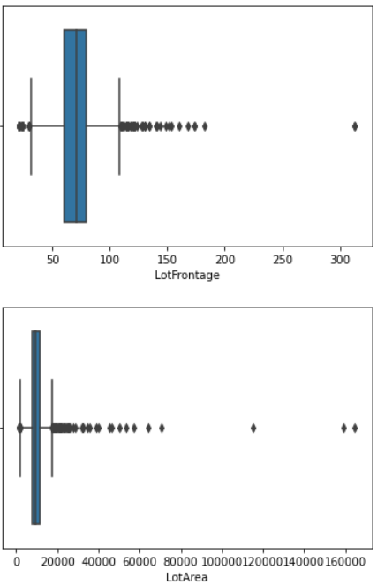
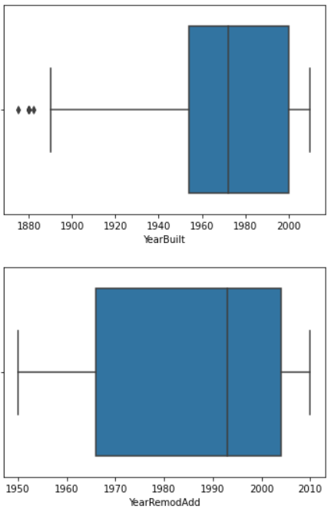
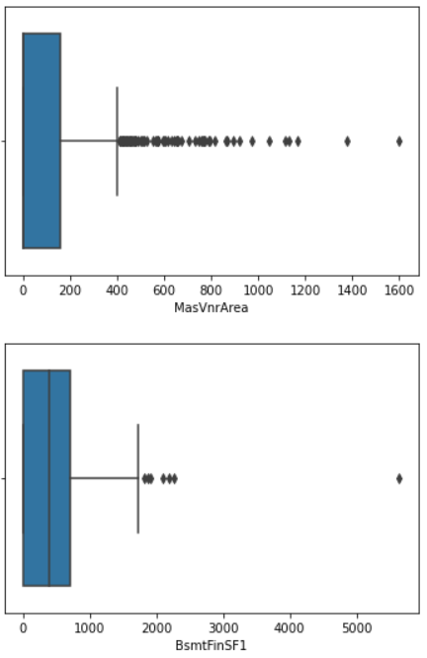
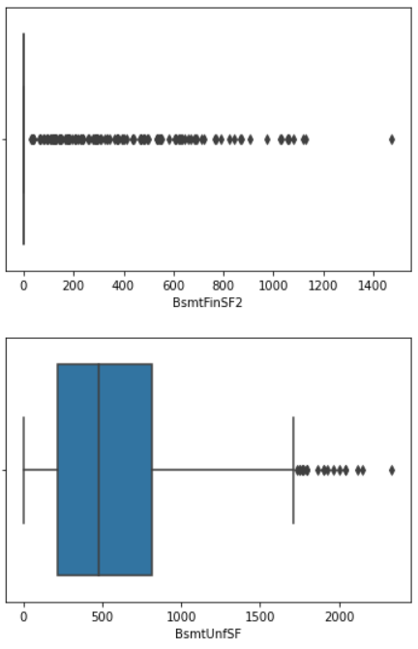
Data analysis
Check For outliers by visualizing Boxplot of every column having datapoints of continuous nature

Slide 35
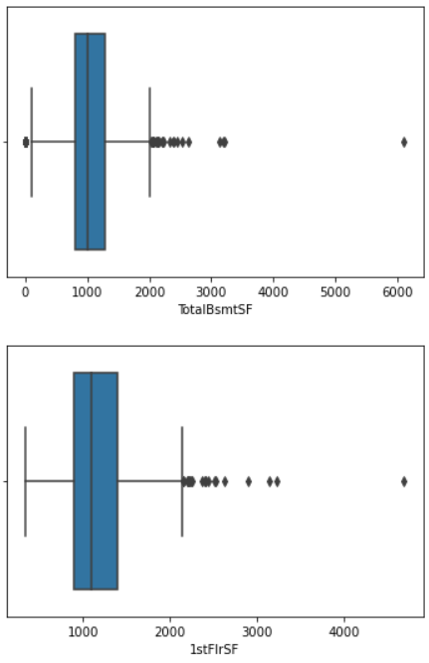
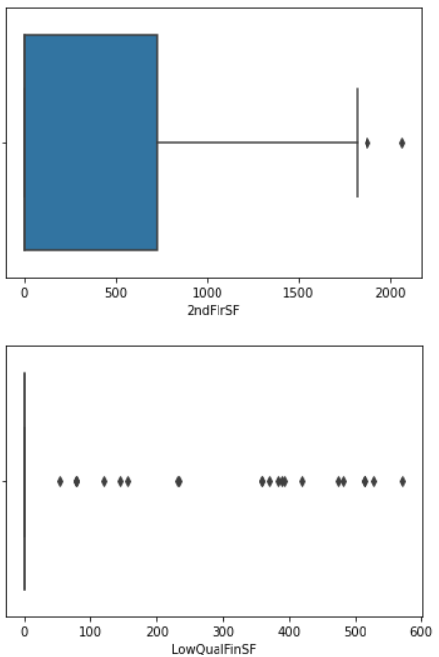
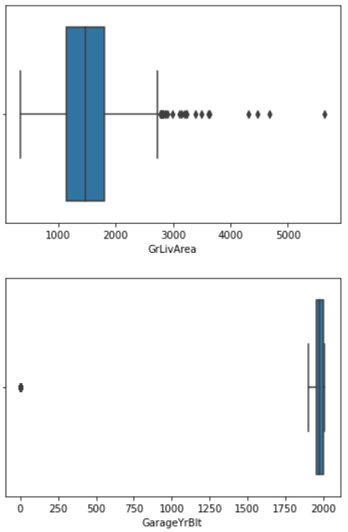
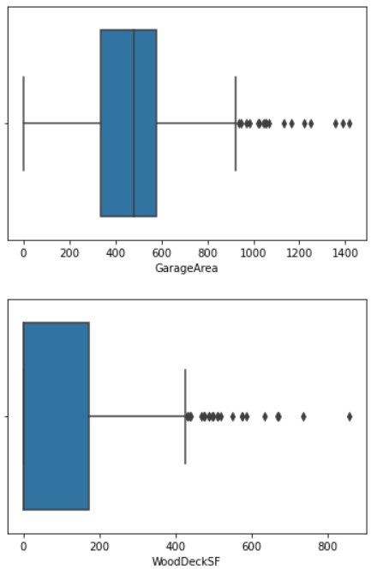
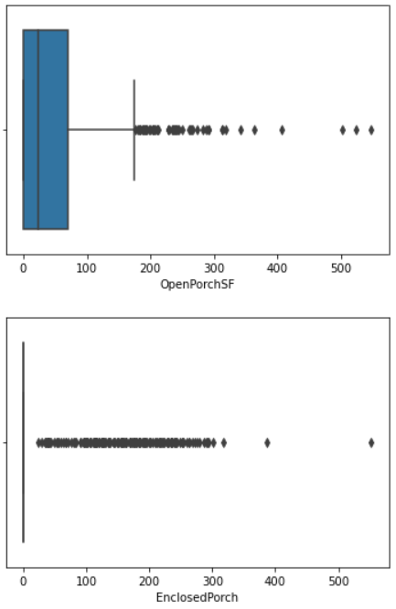
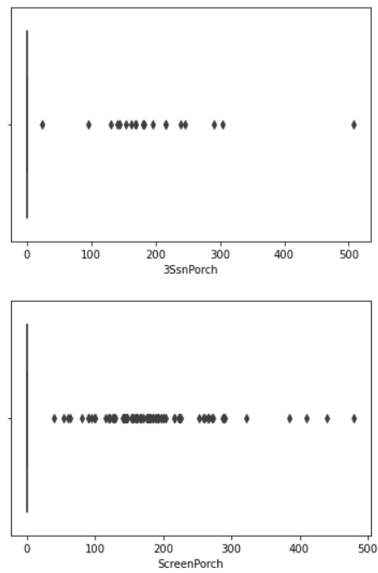

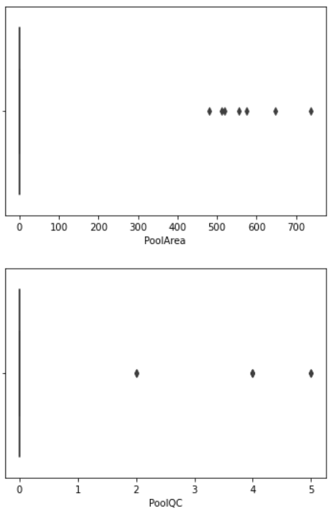
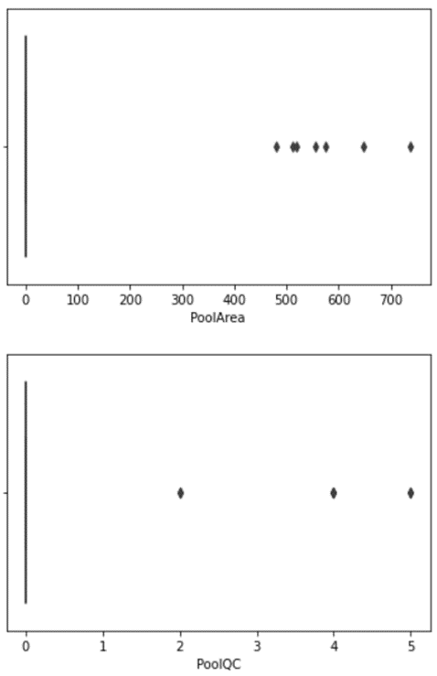
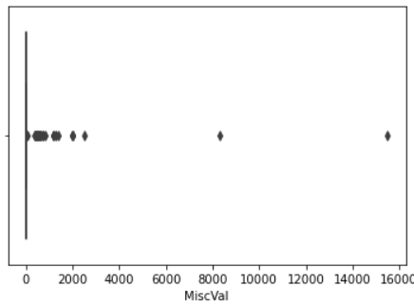
Observation:
Outliers were detected using boxplot
Percentile method was used to reduce outliers

Slide 36
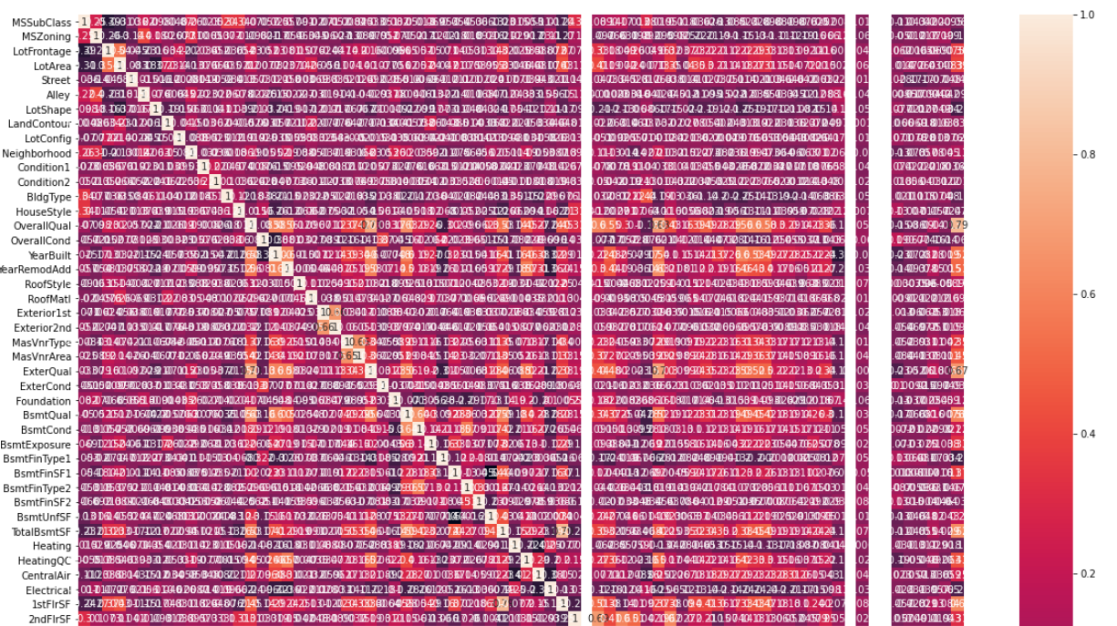
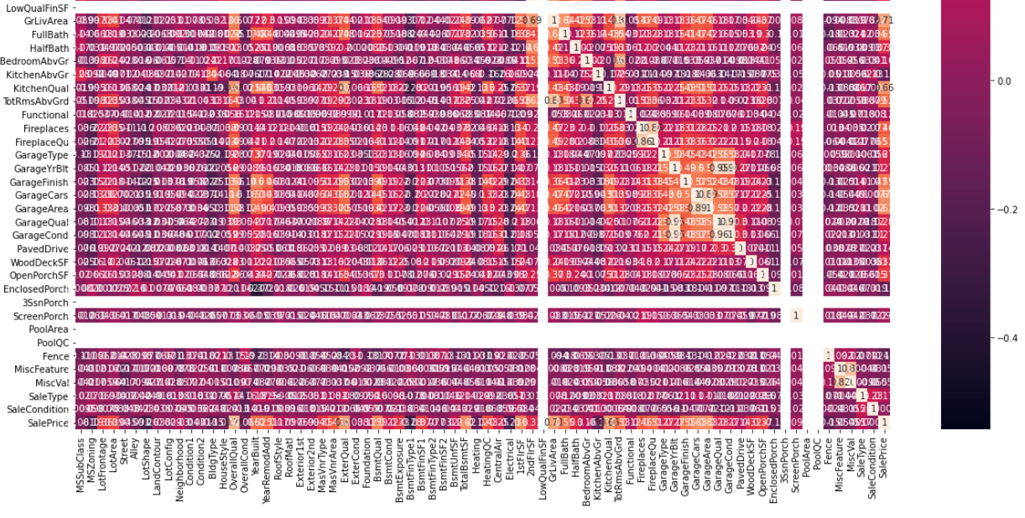
Data Analysis
Check Correlation using heatmap
Observation:
Very few columns have high correlation with column SalePrice but further dropping of column is not possible as we cannot drop more than 10% of columns w.r.t the original dataset.

Slide 37
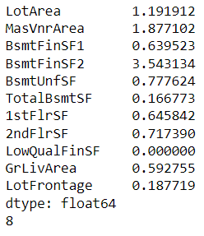
Model Development & Evaluation
Feature Scaling is required to standardize the independent features present in the data in a fixed range, hence it is applied on data before we use this data to build a model.
After that we also need to reduce skewness otherwise our model might get biased and overfit.
As we can observe there is skewness present in 8 columns of dataset having numerical datapoint.

Slide 38
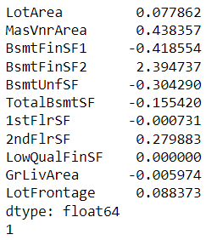
Model Development & Evaluation
We need to reduce skewness using Yeo-Johnson method.
As we can observe after applying Yeo-Johnson method skewness of all those columns is removed.
This will help in avoiding model biasing.
Now we shall find the best models and best random split of train test split to build the most optimized models and fine tune them.

Slide 39
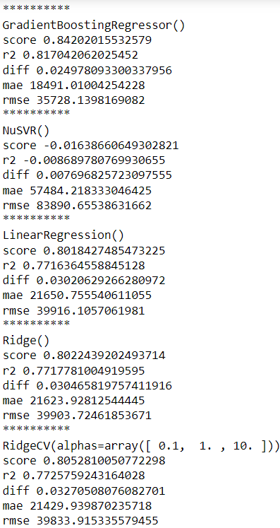
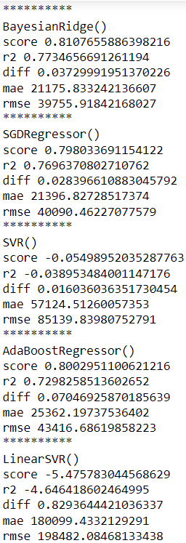
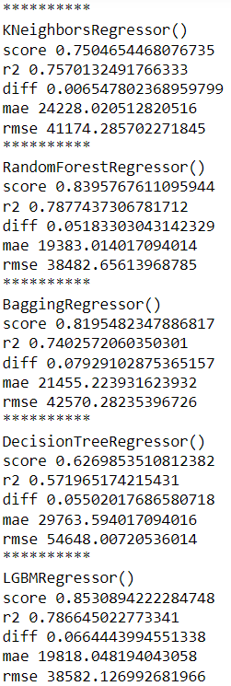
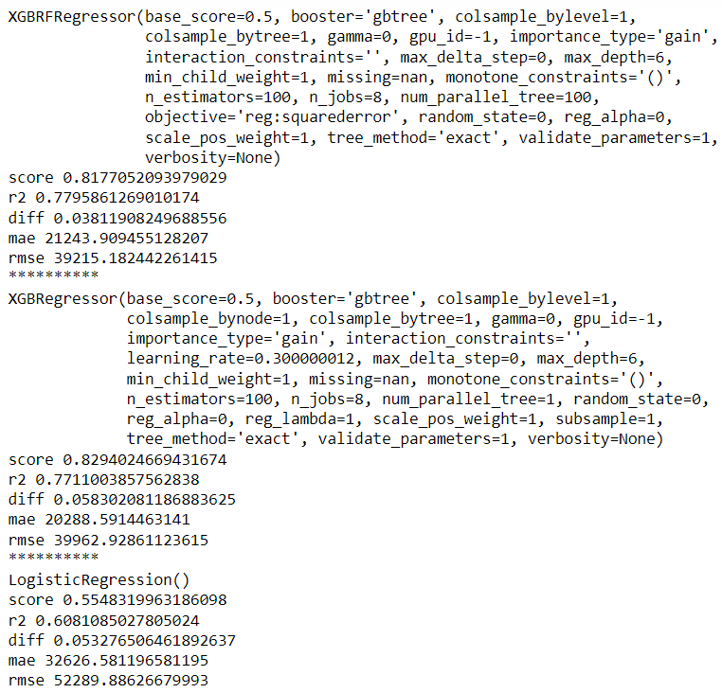
Model development & evaluation

Slide 40
Model Development & Evaluation
After iterating through all regression models we found the following models as our top 5 highest performer:
ExtratreesRegressor
LGMBRegressor
GradientboostingRegressor
RandomForestRegressor
XGBRegressor
Fine-Tune these models by using their best parameters obtained after executing GridSearchCV or RandomizedSearchCV.
Find the best random split for ExtratreesRegressor model and use it to split the dataset into train and test dataset.

Slide 41
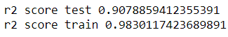

Model development & Evaluation
As we know from above output that our top models do not have accuracy above 90%, hence we will stack our top 5 models to build one model to obtain higher accuracy.
To stack models, we must use StackCVRegressor to combine all our fine tune models.
After using StackCVRegressor we obtain test accuracy of more than 90%.
CV score of this model is more than 87%.

Slide 42

Results
To analyze our model, we shall find the difference between actual and predicted value.
Value difference between actual and predicted value when actual value is greater than predicted value is 89259
Value difference between actual and predicted value when actual value is less than predicted value is 95990
Avg difference between actual and predicted value is 193

Slide 43

Results
Display regression plot for actual datapoints vs predicted datapoints.

Slide 44

Results
Plot distribution graph for both actual and predicted value.
Observation:
From above 2 plots we can observe the closeness between actual and predicted value.
Hence, we can verify that the model built is able to predict SalePrice with a high accuracy.
Save model for further use.

Slide 45

Results
Perform the same data processing steps for test dataset & predict the value for target variable using the existing model and save the result in a csv file

Slide 46
Conclusion
In this project we have tried to show how the house prices vary and what are the factors related to the changing of house prices. The best accuracy score was achieved by stacking our top 5 fine-tuned models.
Stacked Model was built having accuracy more than 90% using train dataset.
Finally, we predicted the SalePrice for Test dataset using our stacked model and saved the data frame into a CSV file

Slide 47
Limitation and scope for future work
While we couldn’t reach out goal of minimum RMSE in house price prediction without letting the model to overfit, we did end up creating a system that can with enough time and data get very close to that goal.
As with any project there is room for improvement here.
The very nature of this project allows for multiple algorithms to be integrated together as modules and their results can be combined to increase the accuracy of the final result.
This model can further be improved with the addition of more algorithms into it.
However, the output of these algorithms needs to be in the same format as the others.
Once that condition is satisfied, the modules are easy to add as done in the code.
This provides a great degree of modularity and versatility to the project.

Slide 48
Thankyou

